Slide 1






Your Smart Social Media Manager Panel

Slide 2

Benefits of AI Zuzi social media manager
Save time by prescheduling posts
Regularly appear on your client’s social media apps to engage your audience
Avoid writer’s block with our AI post writing tool
Have a secure plan for your posts – create a post timetable so that you do not have to worry about posting

Slide 3
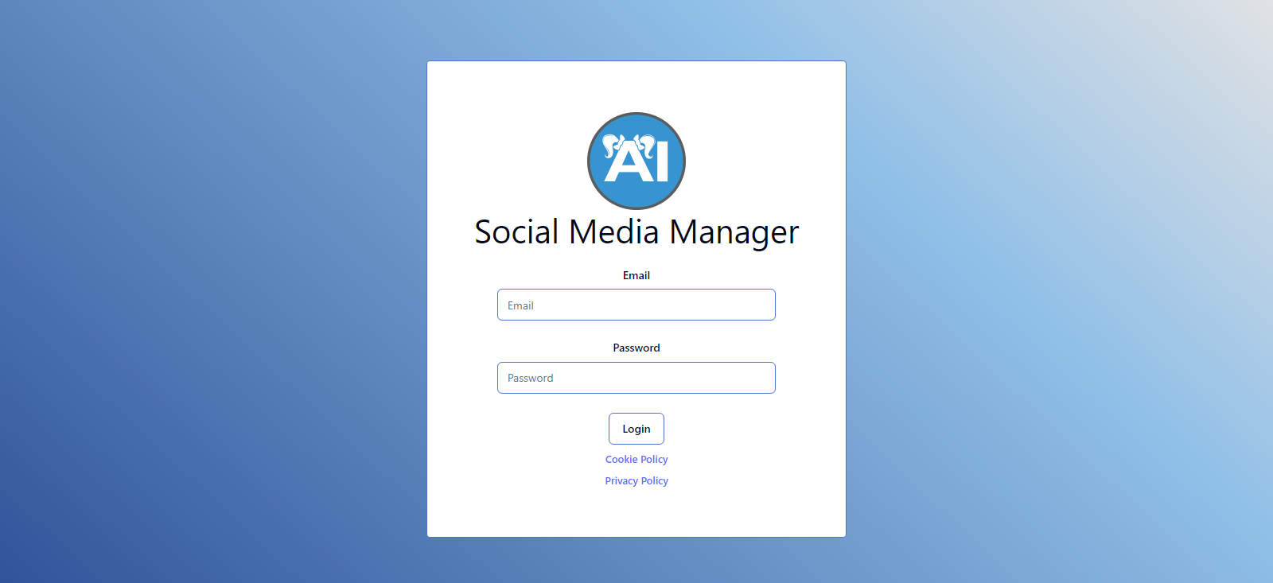
INSTRUCTIONS
Step 1:
Login in with your email
and password.

Slide 4

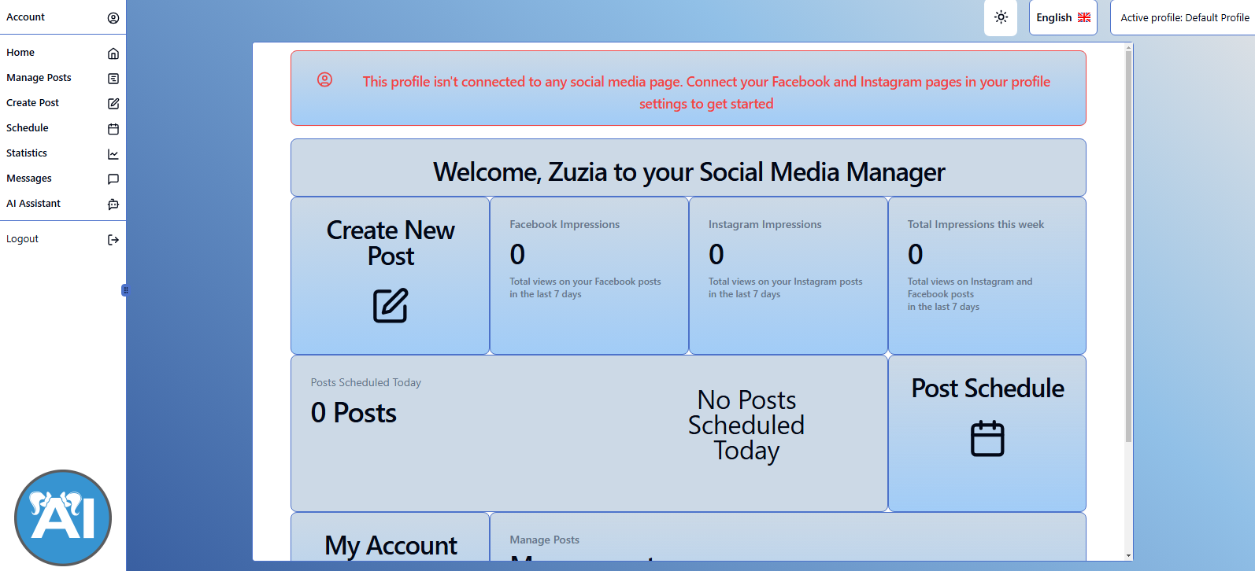
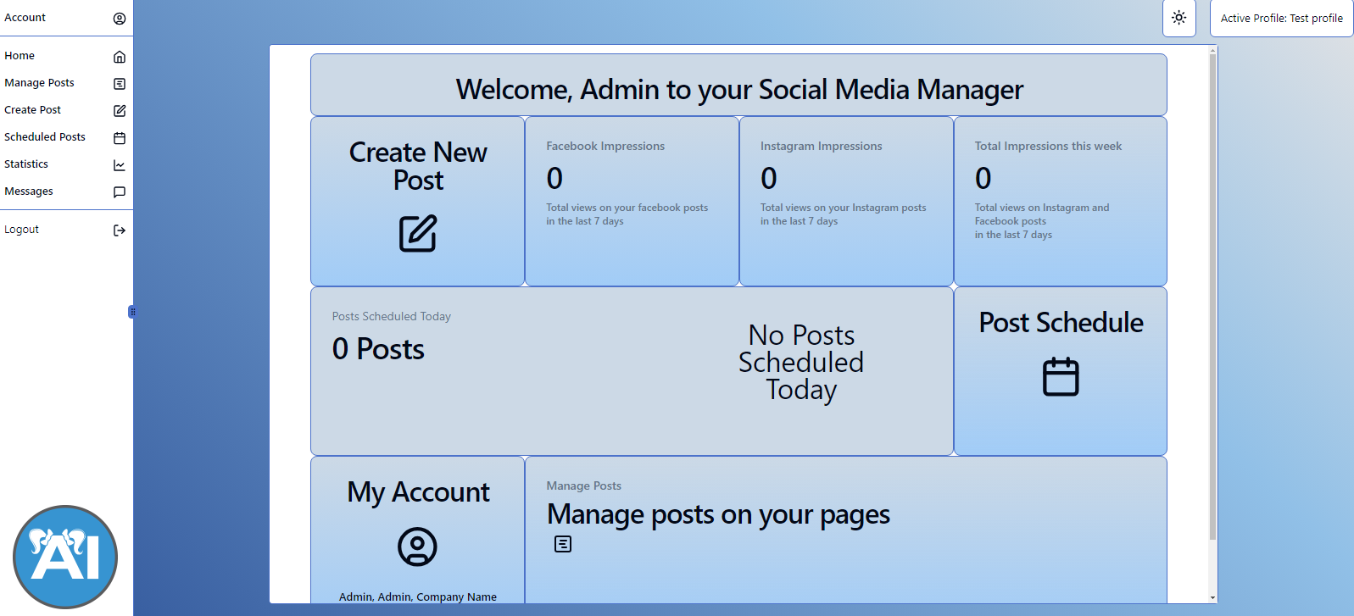
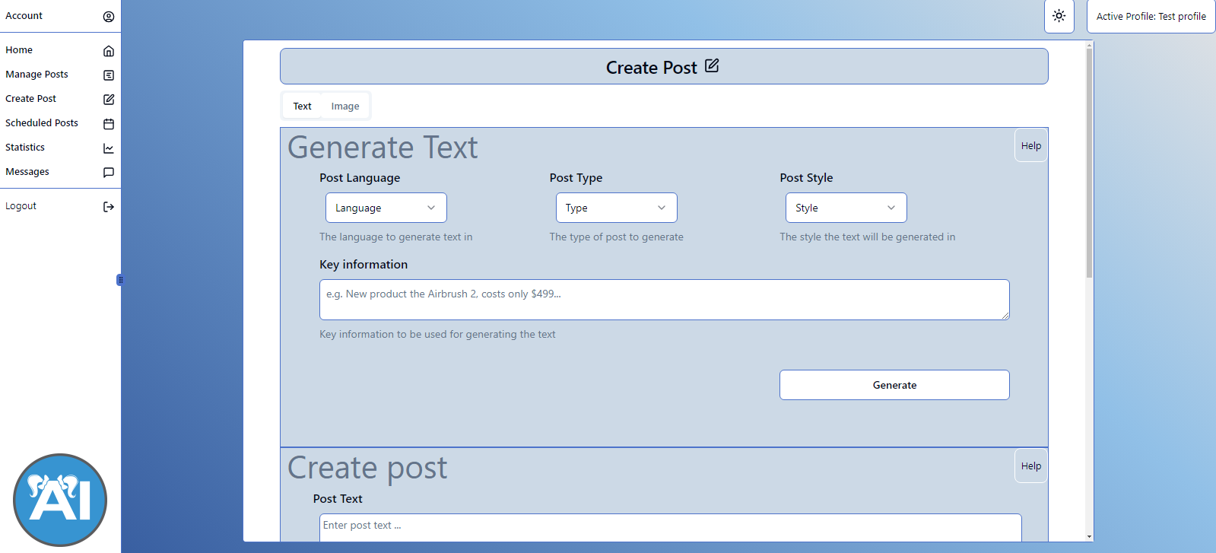
Your main panel

Slide 5
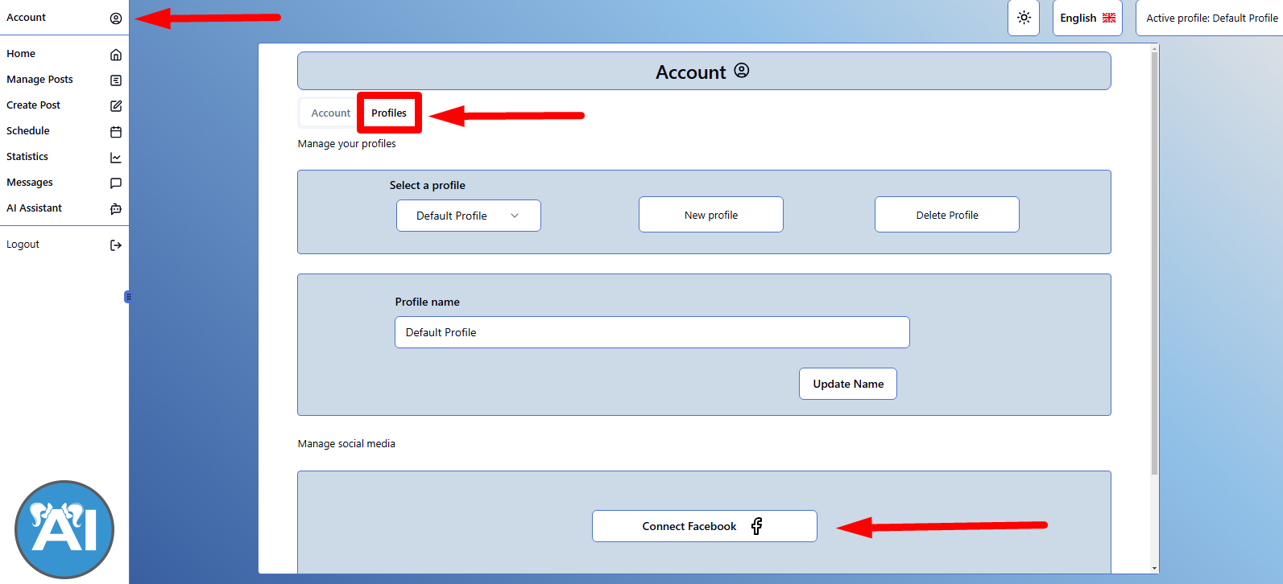
ACCOUNT
The first thing you must do is connect your social media account to your Social Media Manager account.
To do this first go onto the ‚account section’, click ‚profiles’, then at the bottom of the site click the button ‚connect to Facebook’
YOU MUST HAVE A BUSINESS FACEBOOK AND INSTAGRAM ACCOUNT

Slide 6
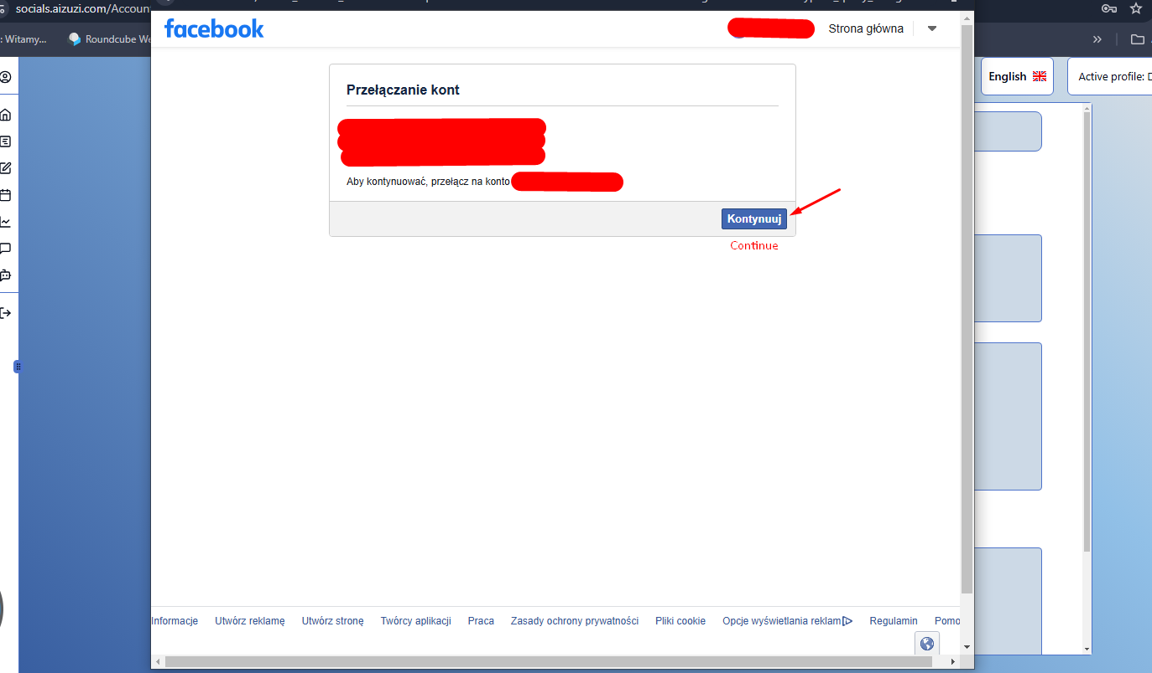
A new window will pop up, where you must now log into your Facebook account

Slide 7
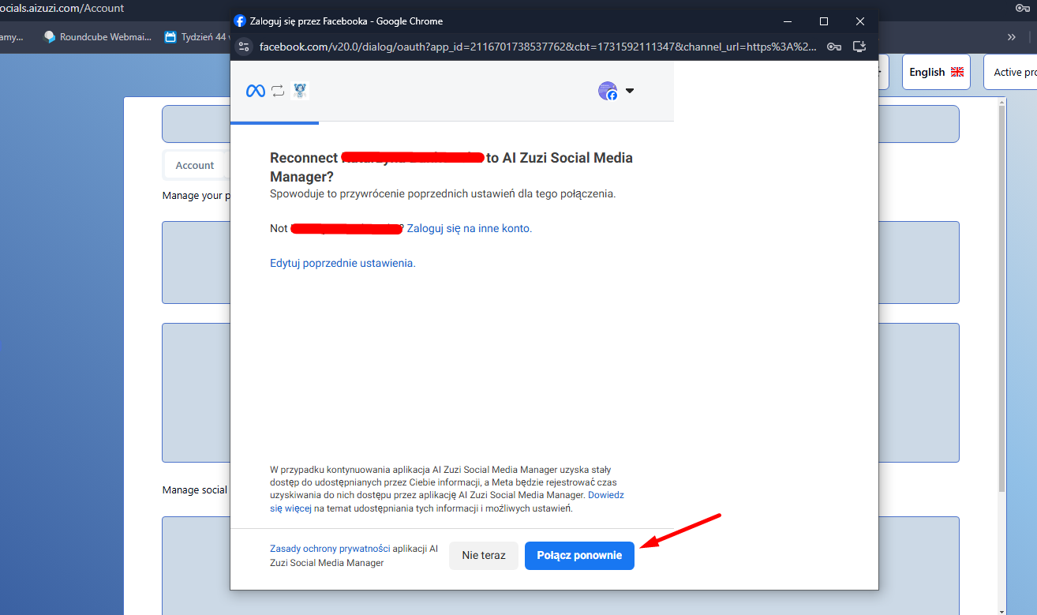

Slide 8
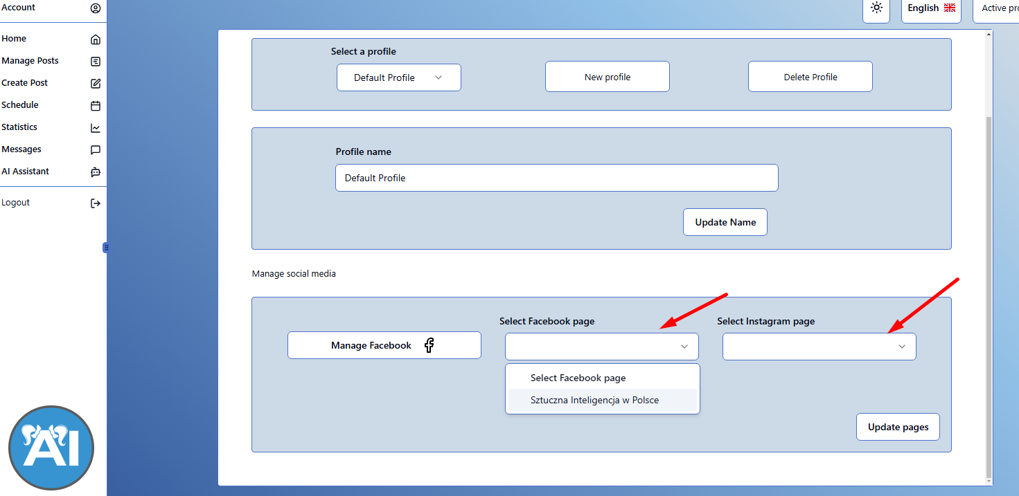
Once you have successfully logged onto your social media platforms then you must choose a Facebook and Instagram page to connect to your account. Once you have done this click the button ‚update pages.’

Slide 9
INSTRUCTIONS HOW TO CONNECT FACEBOOK & INSTAGRAM ACCOUNTS TO THE SOCIAL MEDIA MANAGER PANEL
In order for your Facebook and Instagram account to work on the Social Media Manager Panel you must first have a business portfolio in the Meta Business Suite and Business Manager.
Click the link below to find out how to make a Meta business portfolio:
https://www.facebook.com/business/help/1710077379203657
Below is a link with instructions on how add your Facebook account to your business portfolio in the Meta Business Suite:
https://www.facebook.com/business/help/720478807965744?id=420299598837059
Click the link below to find out how to connect an Instagram account in your Facebook account:
https://www.facebook.com/business/help/620548115562686?id=916550222172854&ref=search_new_3

Slide 10
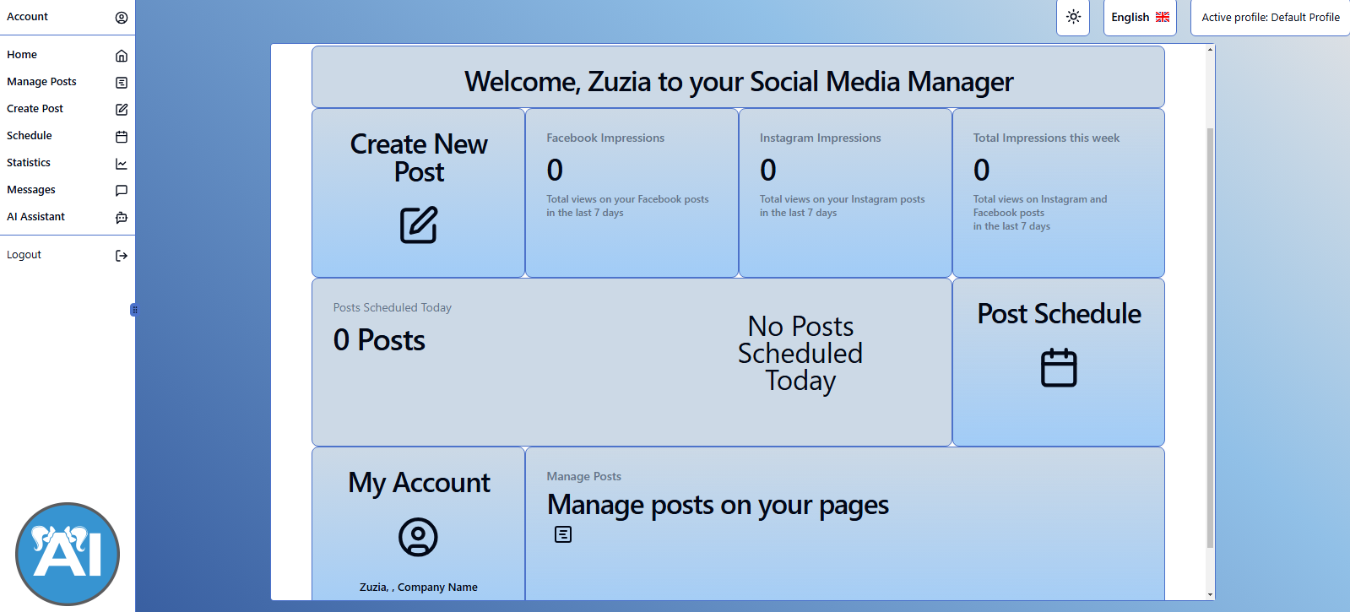

Slide 11
CREATE A POST

Slide 12
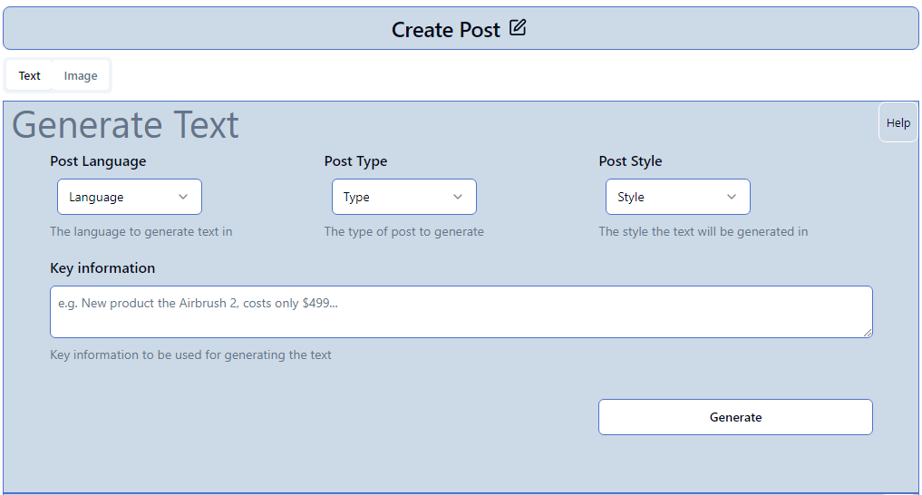

GENERATE TEXT
Create your own post caption just with a few clicks !
Choose your desired language, what type of post you plan on posting, and what writing style you want generated.
Next, in the ‚key information’ section explain what you are posting about, whether you are announcing a new product, or letting your clients know about a discount, give as much detail as you can to generate the perfect text.

Slide 13
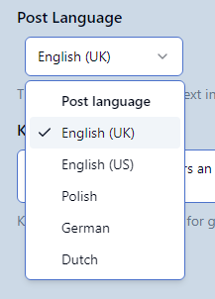
POST LANGUAGE
‘Post language’ - First choose what language you want the generated text to be in

Slide 14
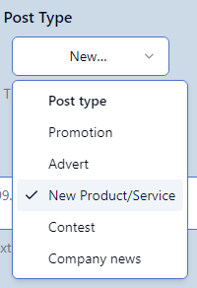
‘Post type’ – Choose what kind of post you plan on sharing
Promotion – choose this option if you wish to announce a sale
Advert – choose this option if you want to advertise your products/services
New product/service – choose this option if you have a new product/service that you wish to announce
Contest – choose this option to announce a contest, tell your clients how they can enter
Company news – choose this option if you want to inform your clients about some new company news
Depending on which option you choose, the programme will generate your post text according to what you want to announce to your audience.
POST TYPE

Slide 15
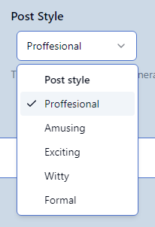
Post style – You can additionally choose the writing style in which your text will be generated. You can choose any of the following options:
Professional
Amusing
Exciting
Witty
Formal
Depending on which of the options you choose, the text will be generated according to the writing style that you have chosen.
POST STYLE

Slide 16
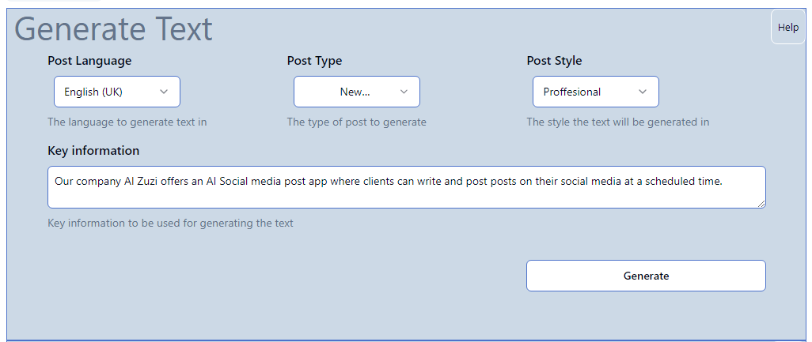
EXAMPLE

Slide 17
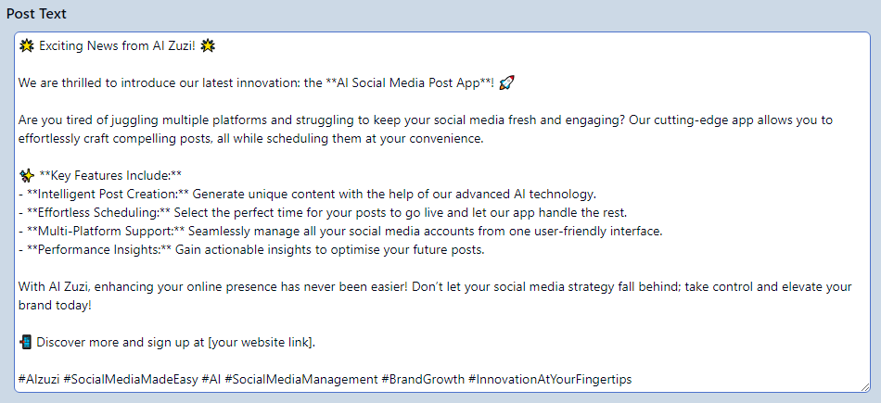
GENERATED POST

Slide 18
GENERATED POST
If the text is not up to your standards, you can regenerate the text, change or add information, or insert a completely different text. The possibilities are endless !

Slide 19
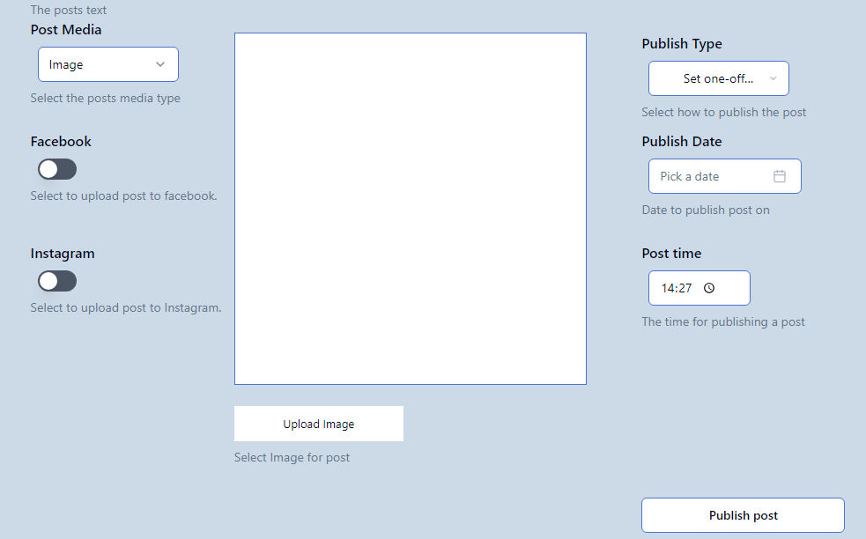
CHOOSE YOUR POST

Slide 20
In this section you can choose the post media that you wish to upload (photo/video)

Slide 21
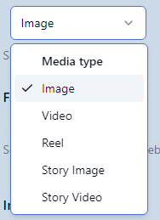
Choose between the following:
Image
Video
Reel
Story image
Story video

Slide 22
Click here to choose the image/video of your choice

Slide 23
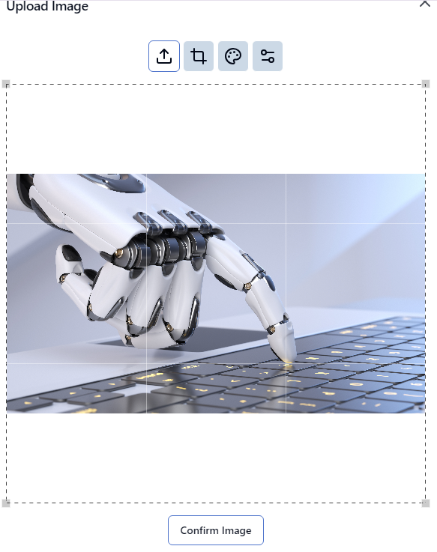

Slide 24
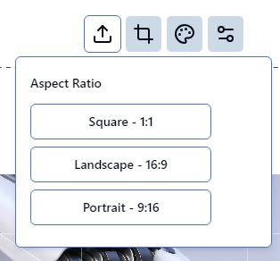
Crop the image manually, or choose from the range of options below

Slide 25
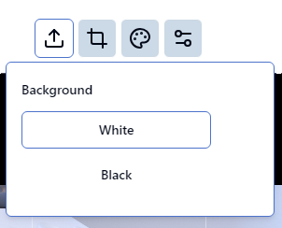
Choose your background –
black/white

Slide 26
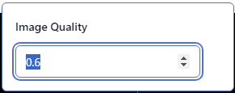
Choose your desired image quality

Slide 27
Choose your desired image quality

Slide 28
PUBLISH TYPE, DATE, TIME
In this section you can choose exactly when you want your post published.

Slide 29
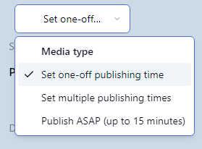
Publish types options
Set one-off publishing time – set a time and date when you want your post published (one off). You must choose a date and a time when you want the post published.
Set multiple publishing times – set multiple dates when you want your post published.
Publish ASAP – publish a one-off post immediately.
PUBLISH TYPE

Slide 30
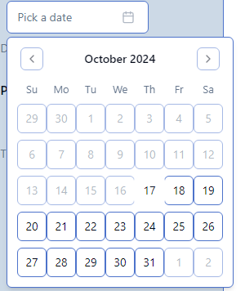
Unless you decide to post ASAP, you have the option to choose an exact date when you want your post uploaded. Click your desired date.
PUBLISH DATE

Slide 31
Unless you decide to post ASAP, you have the option to choose an exact time when you want your post uploaded. Enter your desired time.
PUBLISH TIME

Slide 32
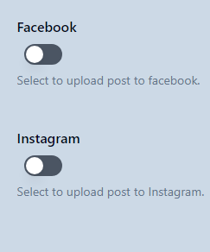
SOCIAL MEDIA
Choose which social media you want your post uploaded to.

Slide 33
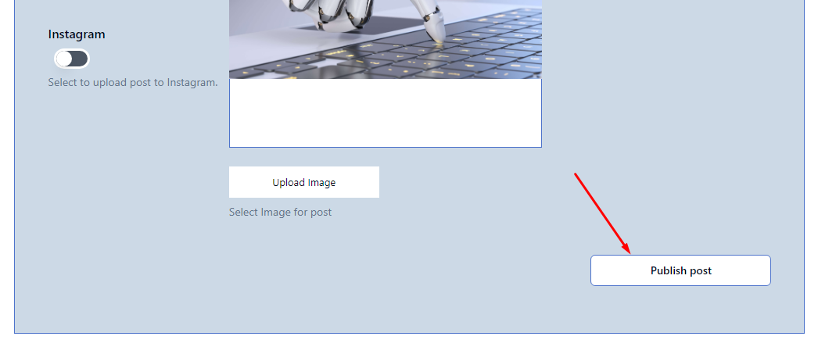
PUBLISH POST
Once you are happy with your post, simply click ‚publish post’

Slide 34
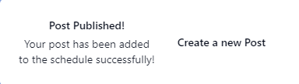
Congratulations ! Your scheduled post has been published, or added to the post timetable to be published at a later time.

Slide 35
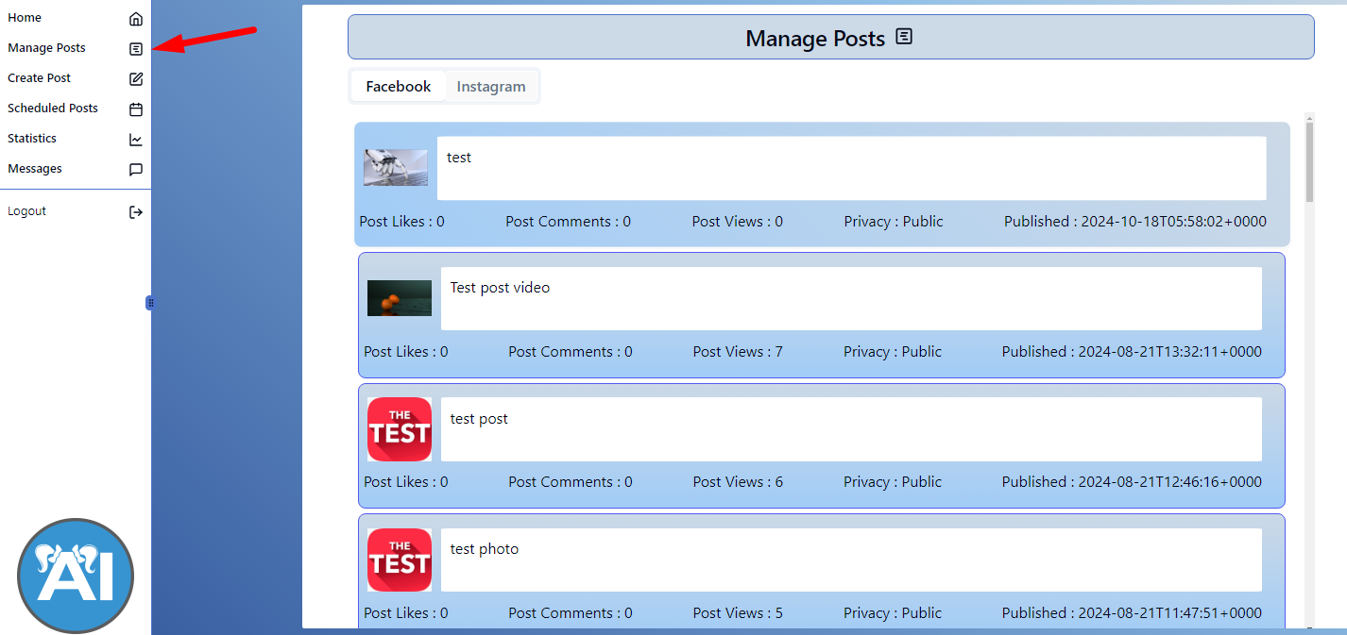
MANAGE POSTS
In the menu click ‚manage posts’ to check out ALL of the posts on your social media accounts.

Slide 36
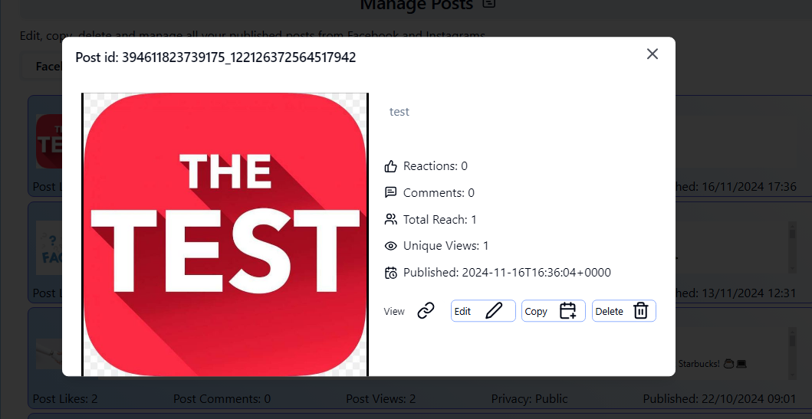
MANAGE POSTS
In this section of the panel you will be able to view ALL POSTS UPLOADED ON YOUR SOCIAL MEDIA ACCOUNTS. This includes posts that had been made directly on the platform, and ones that had been made in the social media panel.
Click on the post of your choice to view, edit, copy, or delete your post.
WARNING !
If you EDIT or DELETE a post in the social media panel, the changes will automatically apply to your social media platform!
You delete a post in the panel
=
You delete the post on your social media account.

Slide 37
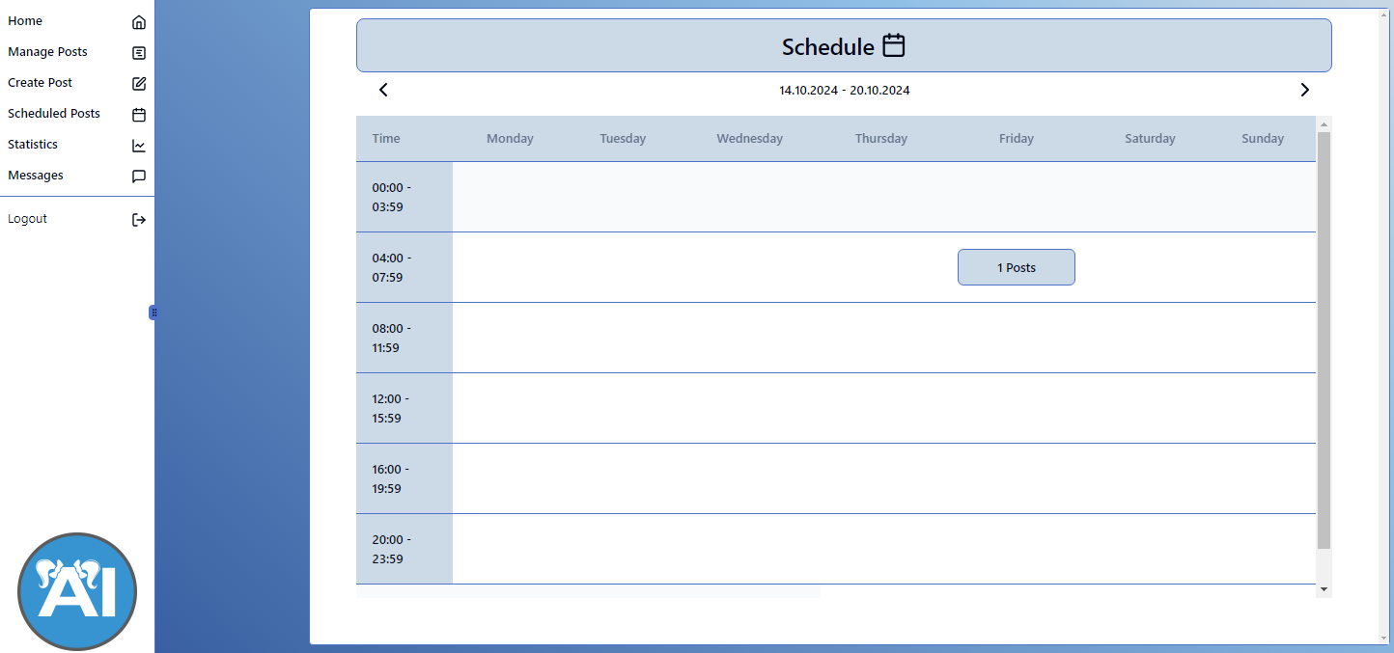

SCHEDULED POSTS
In the menu, find ‚scheduled posts’ and click the tab to see exactly your post schedule.

Slide 38
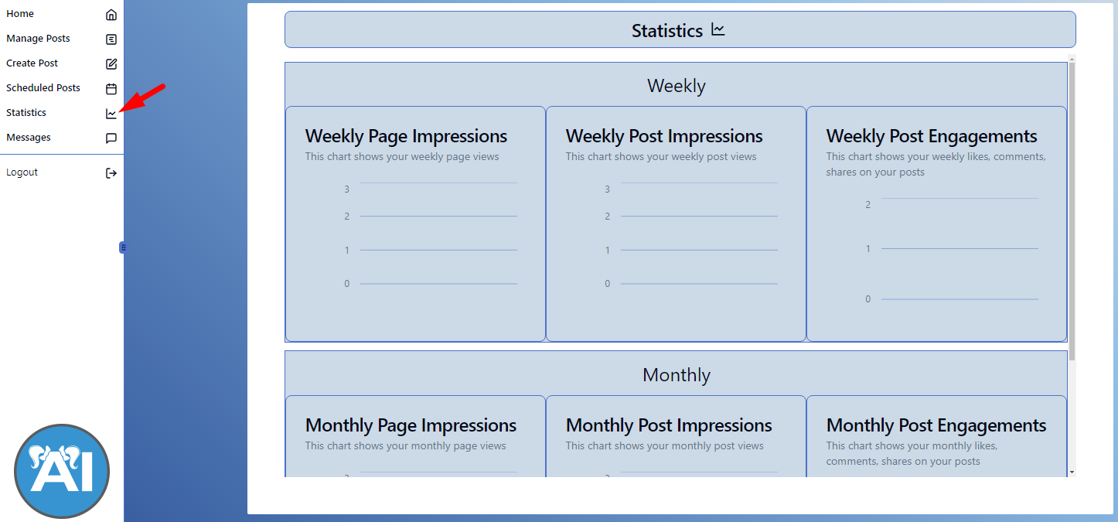
STATISTICS
After consecutively posting posts on our app, you can view your post statistics which will let you know everything you have to know about your post’s engagement with your recipients.

Slide 39
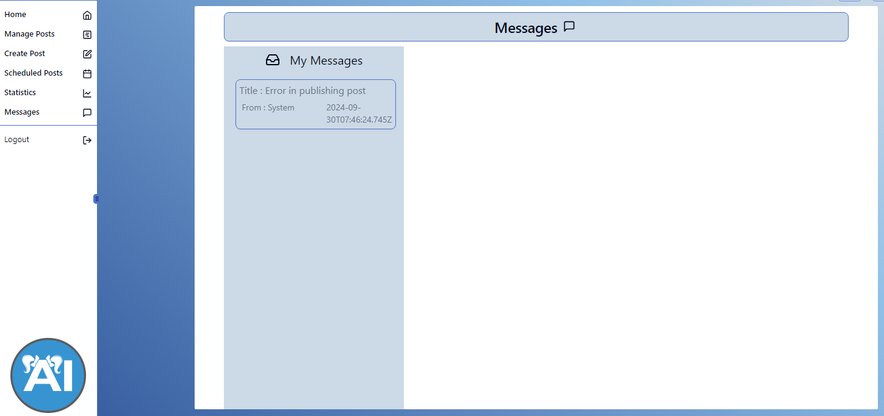
MESSAGES
Our smart system will leave you messages regarding your posts.

Slide 40
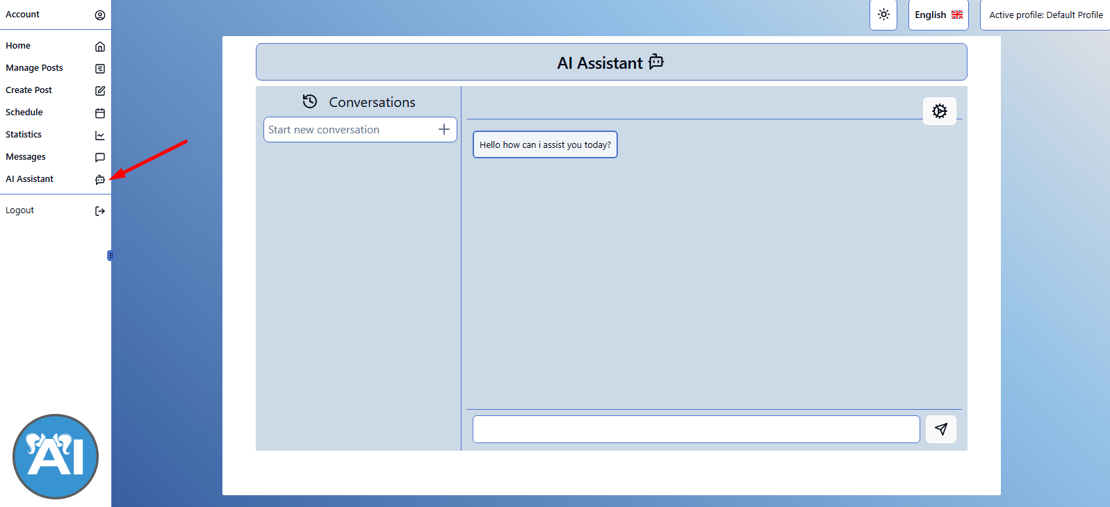
AI ASSISTANT
Use our AI assistant to answer any and all questions that you may have !

Slide 41
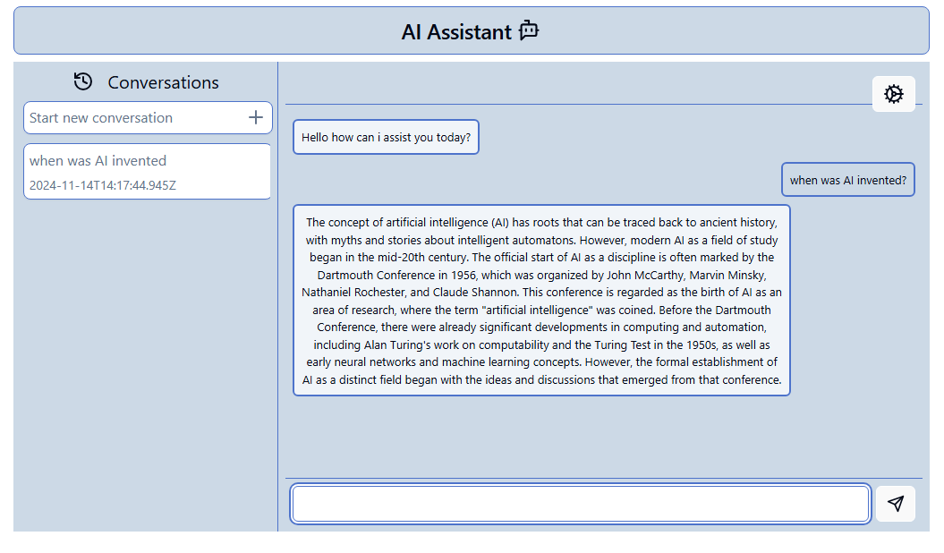
AI ASSISTANT

Slide 42
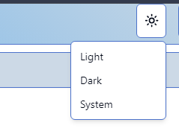
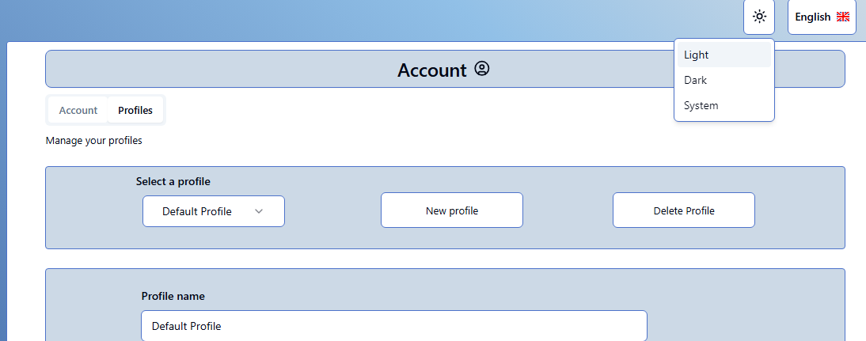
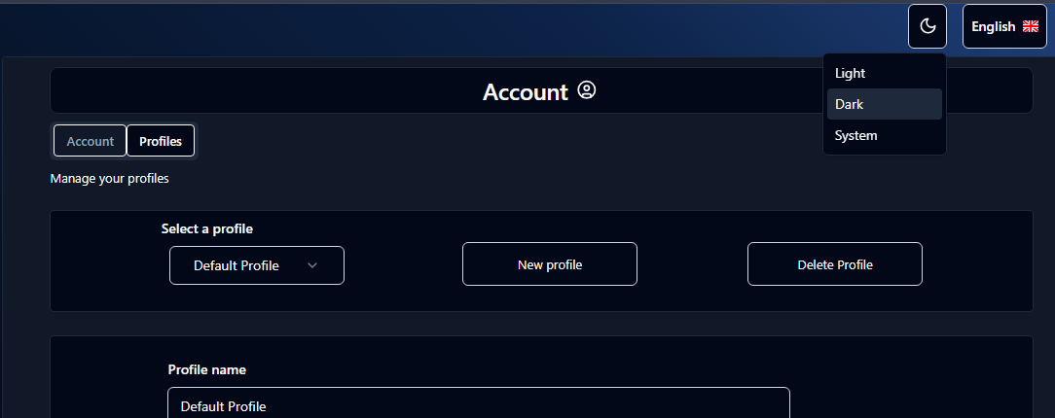
VISUALS
LIGHT MODE
DARK MODE
Change the visuals of your panel depending on your preference, choose light or dark mode !

